Slide 1

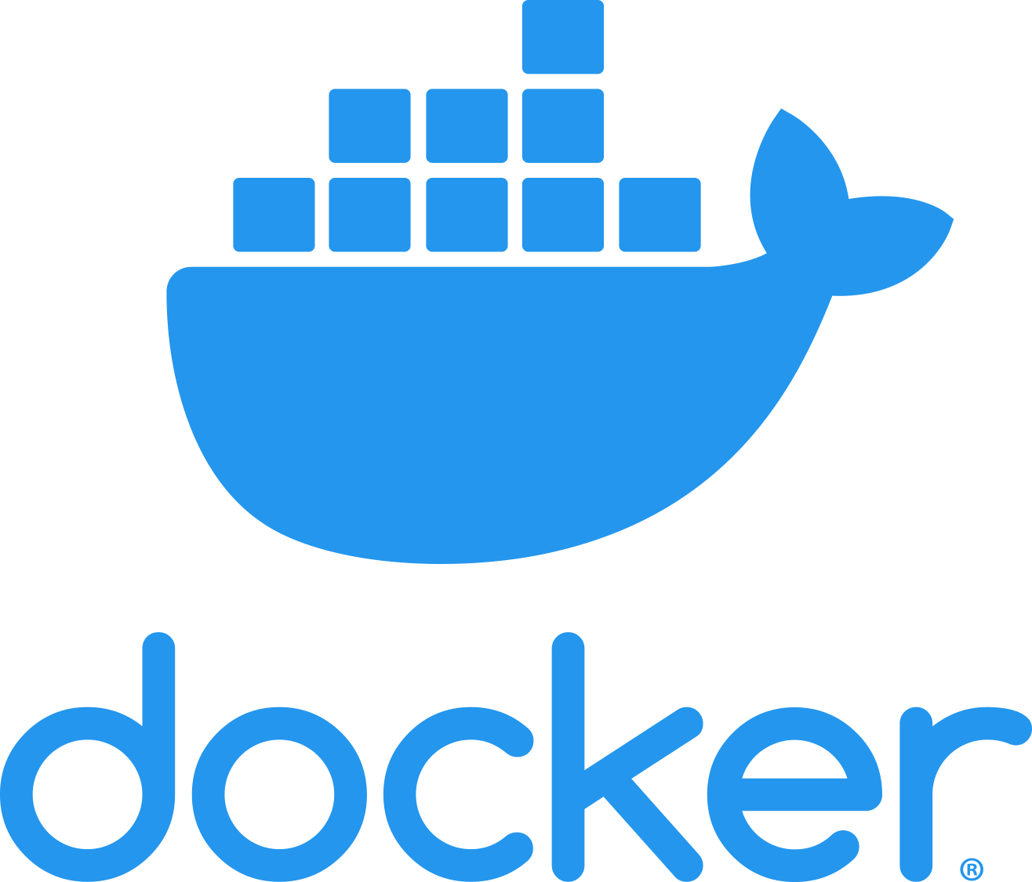
Containerizing Web Apps Using Docker

Slide 2
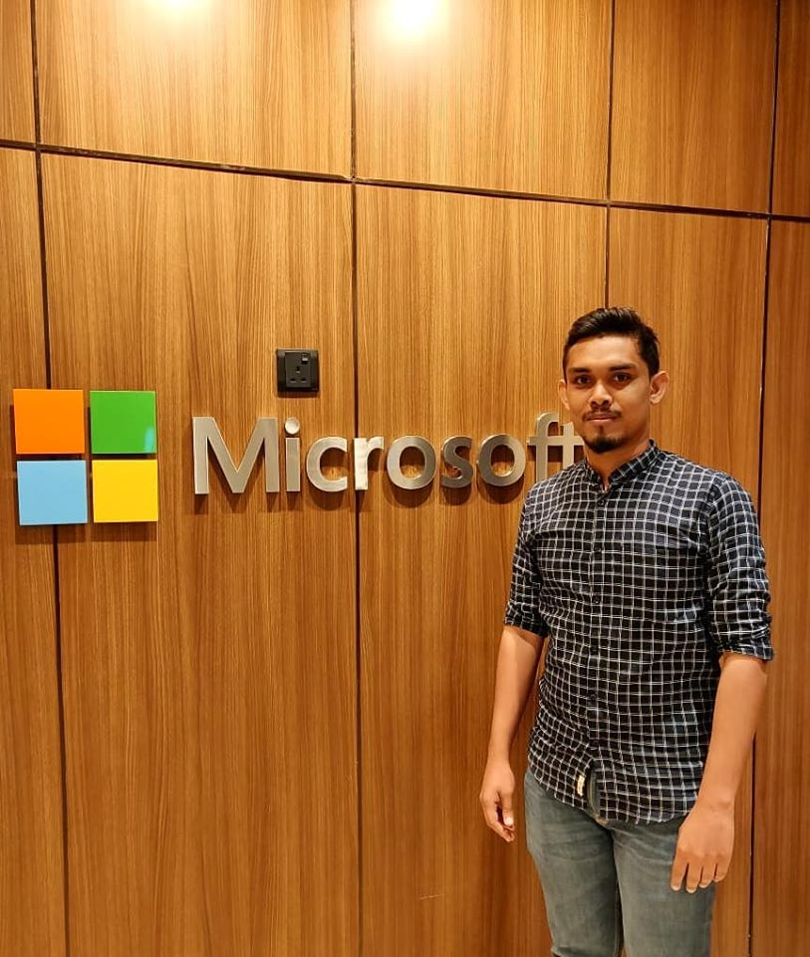
a bit about me
I am Sharaaf Nazeer
Full Stack Engineer | Blogger | Tech Speaker
Contact me through
  https://www.linkedin.com/in/sharaaf-nazeer-95844a98/
  https://www.facebook.com/sharaaf.nazeer
  https://sharaafnazeer.com/

Slide 3
Contents
Overview
What are Containers
Container Vs VMs
What is Docker, Docker architecture and Why do people care
Docker Commands
Create and Publish Docker Image on Docker Registry
Wrapping Up

Slide 4
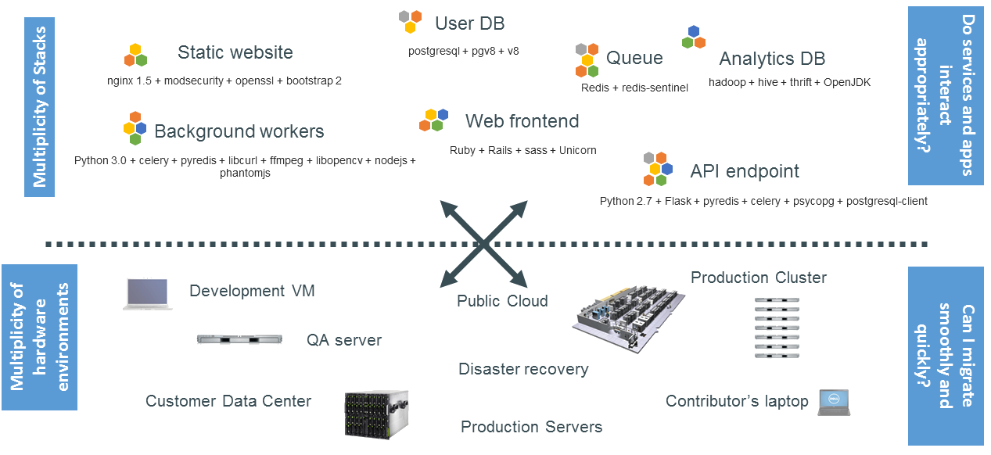

Slide 5
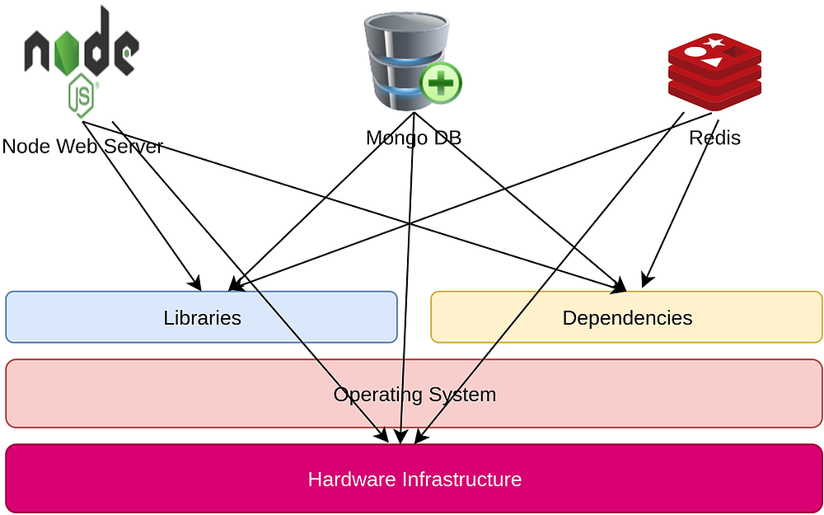
Matrix from hell

Slide 6
What is a container?

Slide 7
A container is a standard unit of software that packages up code and all its dependencies so the application runs quickly and reliably from one computing environment to another.

Slide 8
Container vs virtual machines

Slide 9
Containers and virtual machines have similar resource isolation and allocation benefits, but function differently because containers virtualize the operating system instead of hardware. Containers are more portable and efficient.

Slide 10
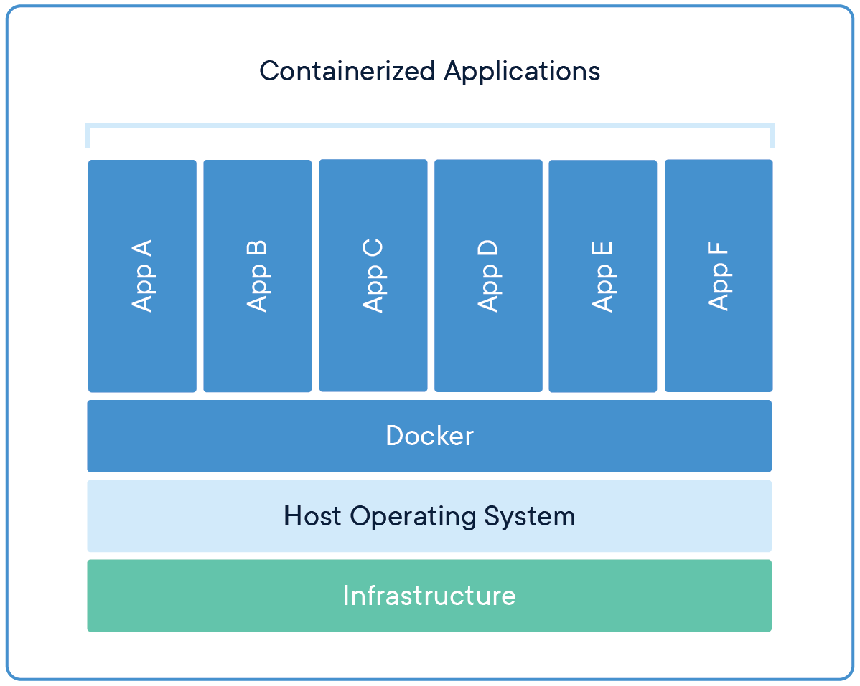
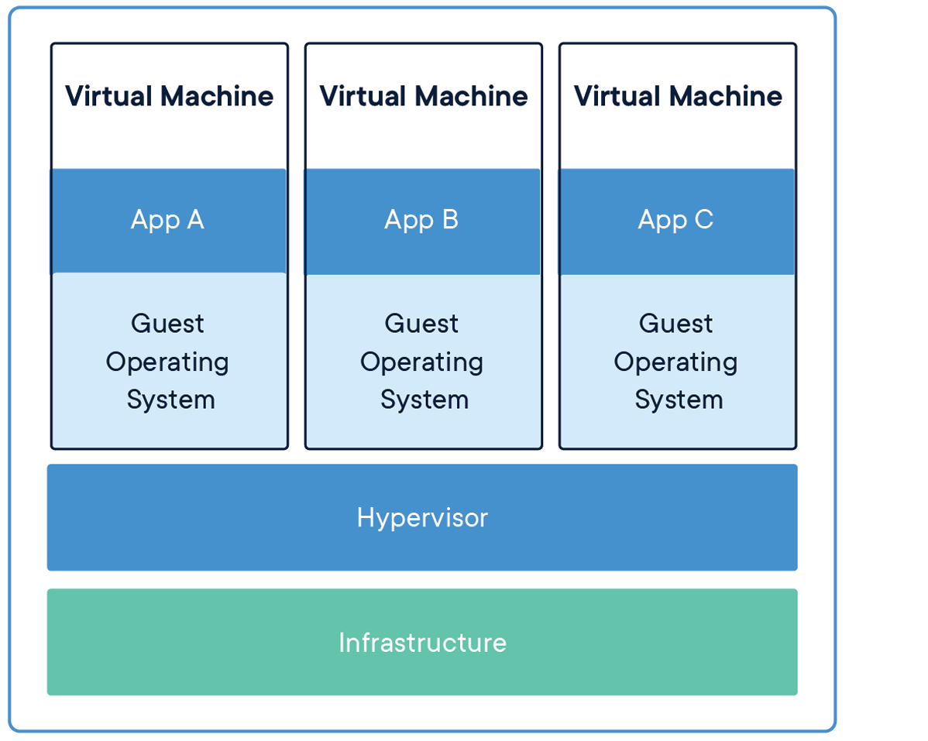

Slide 11
Virtual machines (VMs) are an abstraction of physical hardware turning one server into many servers. The hypervisor allows multiple VMs to run on a single machine. Each VM includes a full copy of an operating system, the application, necessary binaries and libraries - taking up tens of GBs. VMs can also be slow to boot.
Containers are an abstraction at the app layer that packages code and dependencies together. Multiple containers can run on the same machine and share the OS kernel with other containers, each running as isolated processes in user space. Containers take up less space than VMs (container images are typically tens of MBs in size), can handle more applications and require fewer VMs and Operating systems.

Slide 12

 | VMs | Containers
Security | More isolated | Less isolated
Size | GBs | MBs
Provision | Mins | Secs
OS | More flexible | Less flexible

Slide 13
What is docker?

Slide 14
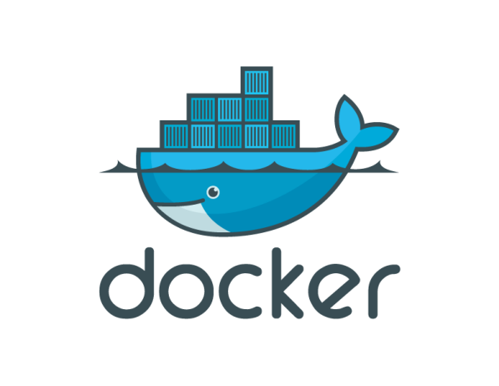
Docker is an open platform for developing, shipping, and running applications. Docker enables you to separate your applications from your infrastructure so you can deliver software quickly.

Slide 15
Why developers care?

Slide 16
Build once, run anywhere
A clean, safe, hygienic and portable runtime environment for your app.
No worries about missing dependencies, packages and other pain points during subsequent deployments.
Run each app in its own isolated container, so you can run various versions of libraries and other dependencies for each app without worrying.
Automate testing, integration, packaging…anything you can script.
Reduce/eliminate concerns about compatibility on different platforms, either your own or your customers.

Slide 17
Why devOPS care?

Slide 18
Configure once, run anything
Make the entire lifecycle more efficient, consistent, and repeatable.
Increase the quality of code produced by developers.
Eliminate inconsistencies between development, test, production, and customer environments.
Support segregation of duties.
Significantly improves the speed and reliability of continuous deployment and continuous integration systems.
Because the containers are so lightweight, address significant performance, costs, deployment, and portability issues normally associated with VMs.

Slide 19
Docker architecture

Slide 20
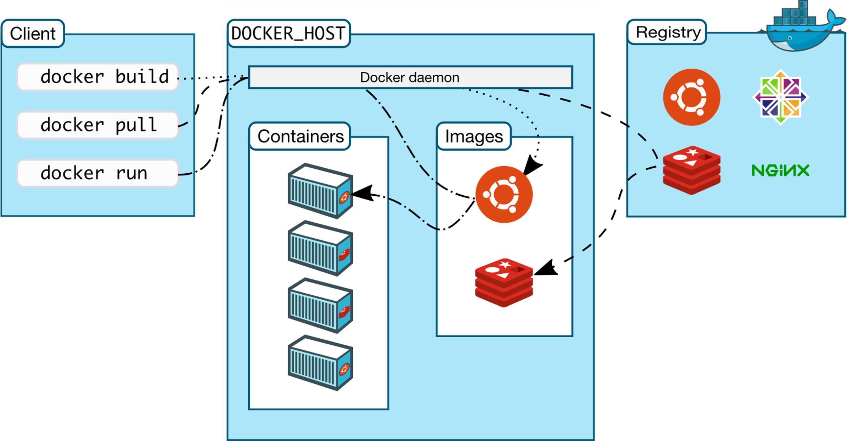

Slide 21
docker Commands

Slide 22
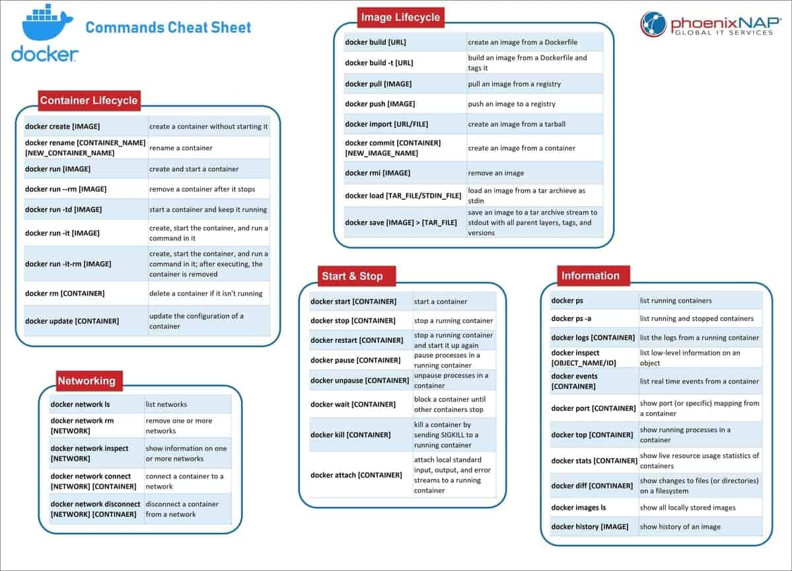

Slide 23
Create docker image

Slide 24
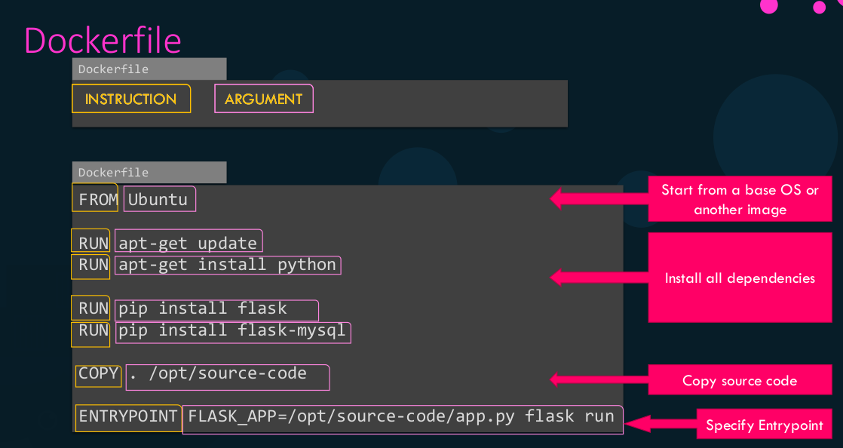

Slide 25
Build Image
docker build . --name python-app
Create Container using Image
docker run --publish 8083:8080 --detach --name python-app-container python-app
Tag Docker Image
docker tag python-app sharaafnazeer/python-app
Push Docker Image to Repository
docker push sharaafnazeer/python-app

Slide 26
Wrapping up any questions ???

Slide 27
Thank you!

